Slide 1
Feedback Fees Management – Design Thinking Workshop
Session 42
Presented by Marchand Hildebrand

Slide 2
DISCLAIMER
This presentation is only a summary of some of Adapt IT’s products, features and their latest developments. Adapt IT only intends for the information to give you an overview, and not a complete and comprehensive statement that necessarily suits your purposes.
Adapt IT reserves the right to change any information contained in this presentation and is not responsible for any loss that results from inaccuracies in the information. You may not distribute or reproduce the information without Adapt IT’s written permission.

Slide 3
Fees Management Design Thinking Workshop
“We sought your input last year so that we could develop our course fees roadmap. Visit us to witness our future-focused approach to managing course fees.”
“

Slide 4
Education Funding Landscape
Notes:
Government funding
Research Grants
Donations and Endowments
Commercial Activities
Universities in South Africa fund tuition through a combination of sources, including government funding, tuition fees paid by students, research grants, donations, and other revenue streams. Here's a breakdown of the main sources of funding for university tuition in South Africa:
Government Funding: The South African government provides funding to universities through the Department of Higher Education and Training (DHET). This funding is allocated to universities based on various factors, including student enrollment, research output, and institutional performance. Government funding covers a significant portion of universities' operating expenses, including faculty salaries, infrastructure maintenance, and student support services.
Research Grants: Universities in South Africa receive research grants from various sources, including government agencies, private foundations, and industry partners. These grants support research projects, academic conferences, and other scholarly activities conducted by faculty members and students. Research grants play a crucial role in advancing knowledge and innovation in various fields and contribute to universities' reputations and rankings.
Donations and Endowments: Universities in South Africa receive donations and endowments from alumni, philanthropists, corporations, and other donors. These funds are used to support scholarships, bursaries, research initiatives, infrastructure projects, and other strategic priorities identified by the university. Donations and endowments help supplement government funding and tuition fees and provide universities with additional resources to invest in academic excellence and student success.
Commercial Activities: Some universities in South Africa engage in commercial activities such as consulting services, technology transfer, and intellectual property licensing. Revenue generated from these activities can supplement other sources of funding and support universities' core academic mission.
Overall, universities in South Africa rely on a diverse mix of funding sources to support their operations and provide high-quality education and research opportunities to students and faculty. The balance between government funding, tuition fees, research grants, donations, and other revenue streams may vary depending on the university's size, mission, location, and financial circumstances.
5. Tuition Fees: Students in South Africa are required to pay tuition fees to attend university. These fees vary depending on factors such as the level of study (undergraduate or postgraduate), the field of study, and whether the student is a domestic or international student. Tuition fees contribute to universities' revenue and help cover the cost of academic programs, faculty salaries, and administrative expenses.

Slide 5
Tuition Fees
Notes:
Tuition Fees
NSFAS + NSFAF
Bursaries
Employers
Student

Slide 6
The net change in the stock of cash from higher education institutions amounted to a cash deficit of R972 million for the 2022 financial year
Notes:
The net change in the stock of cash from higher education institutions amounted to a cash deficit of R972 million for the 2022 financial year.

Slide 7
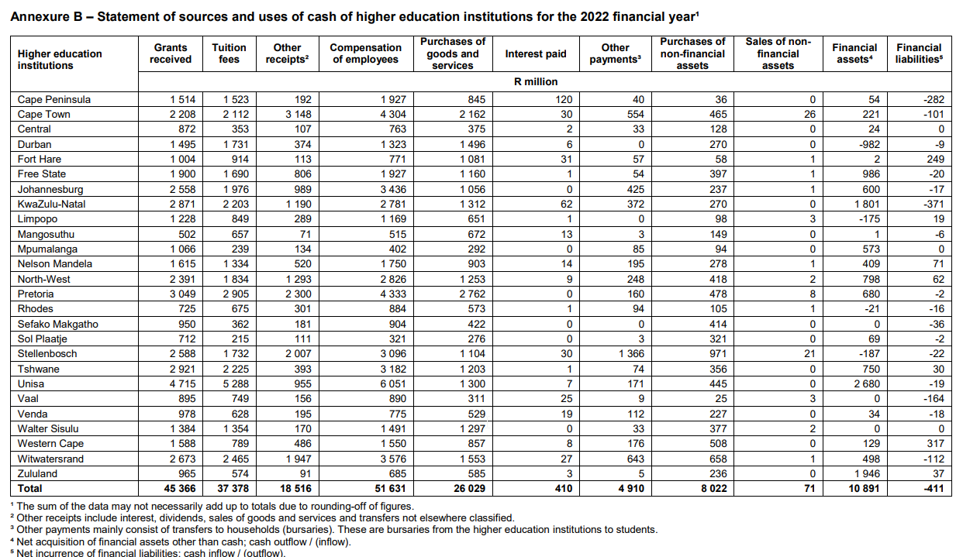
Notes:
The net change in the stock of cash from higher education institutions amounted to a cash deficit of R972 million for the 2022 financial year.

Slide 8
What is course fees ?
Money charged by educational institutions
Cover the cost of instruction, materials, facilities
Fee varies
Duration of the course
Subject matter
Location
Institution's prestige
Charged based on
One-time basis
Duration of the course
Per-semester
Per-module
Notes:
Course fees refer to the amount of money charged by educational institutions or training providers for enrollment in a particular course or program. These fees typically cover the cost of instruction, materials, facilities, and other resources required for delivering the course.
Course fees can vary widely depending on factors such as the level of education, duration of the course, subject matter, location, and institution's prestige.
Course fees may be charged on a one-time basis for the entire duration of the course or on a per-semester, per-module, or per-credit-hour basis. They may also include additional costs such as registration fees, examination fees, laboratory fees, textbooks, and other course-related expenses.
Institutions may offer various payment options, financial aid programs, scholarships, or discounts to help students afford the course fees. Some institutions also offer installment plans or deferred payment options to spread out the cost of education over time.
Course fees are an important source of revenue for educational institutions and play a crucial role in funding academic programs, faculty salaries, facilities maintenance, and other operating expenses. They also serve as a means of ensuring accountability and sustainability in the delivery of educational services.

Slide 9
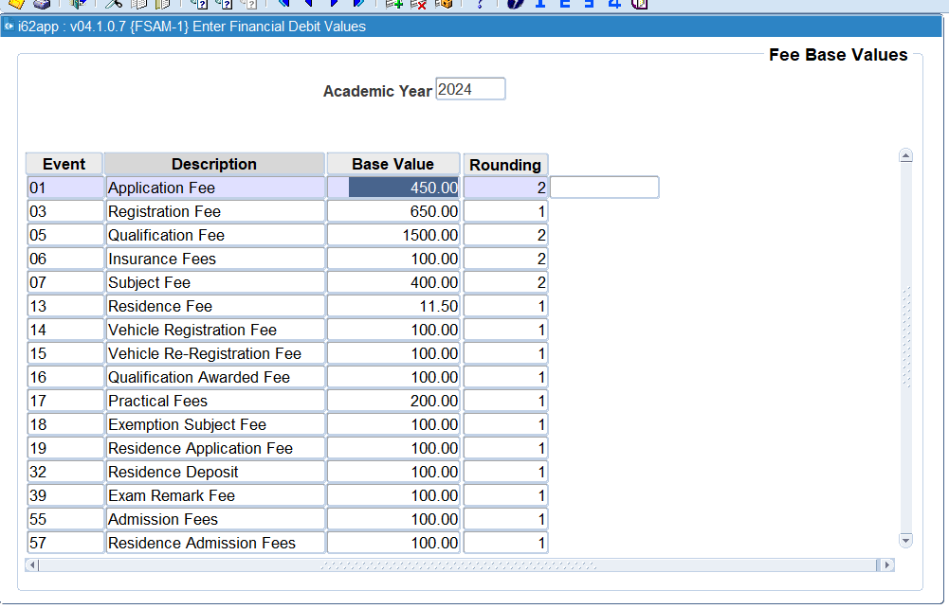
Notes:
Rounding...
Calc base value x fee values – number of decimals.

Slide 10
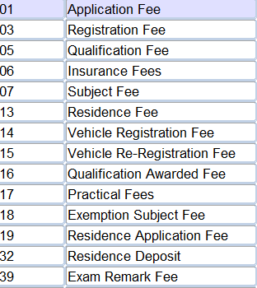
Fee Events
Events Key Fields | 01 | 03 | 04 | 05 | 07 | 13 | 14 | 15 | 16 | 17 | 18 | 19 | 32 | 39 | 55 | 57
Currency | Y | Y | Y | Y | Y | Y | Y | Y | Y | Y | Y | Y | Y | Y | Y | Y
Post/ Under Graduate | Y | Y | Y | Y | Y | N | N | N | Y | Y | Y | N | N | Y | Y | N
Cash/Terms | N | Y | Y | Y | Y | Y | N | N | N | N | N | N | N | N | N | N
Offering Type | Y | Y | Y | Y | Y | N | N | N | N | Y | N | N | N | Y | Y | N
Study Period | Y | Y | Y | Y | N | N | N | N | N | N | N | N | N | N | Y | N
Student Type | Y | Y | Y | Y | Y | Y | Y | Y | Y | Y | Y | Y | Y | Y | Y | Y
Block Code | Y | Y | Y | Y | Y | Y | Y | Y | Y | Y | Y | Y | Y | Y | Y | Y
Exam Type | N | N | N | N | Y | N | N | N | N | Y | N | N | N | Y | N | N
Transaction Type | Y | Y | Y | Y | Y | Y | Y | Y | Y | Y | Y | Y | Y | Y | Y | Y
Notes:
When we started with the key, the idea was to differentiate on the different prices.
We know that the requirement these days, is to indicate where the revenue needs to be allocated. Only way of doinbg that is to for example have the OT as they key, where you have different CC codes for each OT.
Do we need a complicated KEY functionality to handle the revenue (or account type) differentiator?
Or how do we make this easier to administer.

Slide 11
Debtor systems
Balance Forward System
Cycle Billing System
Statement Billing System
Recurring Billing System:
Credit Memo System:
Aging of Receivables/Payables System:
Notes:
In addition to open item systems, there are other methods of managing accounts receivable and accounts payable transactions. Here are some common alternatives to open item systems:
Balance Forward System: In a balance forward system, each transaction is posted to a customer or vendor account as a running balance. Instead of tracking individual invoices or transactions separately, the system maintains a cumulative balance for each account. Payments are applied to the outstanding balance, and the remaining balance is carried forward to the next period. This approach is simpler than open item systems but may be less granular in tracking individual transactions.
Cycle Billing System: In a cycle billing system, invoices are grouped and billed according to predefined cycles, such as weekly, monthly, or quarterly. Instead of invoicing all customers or vendors at once, billing is staggered over multiple cycles to spread out the workload and manage cash flow. This approach helps ensure a steady stream of revenue or payments throughout the billing period.
Statement Billing System: In a statement billing system, customers or vendors receive periodic account statements summarizing their transactions, balances, and payment history. Instead of receiving individual invoices for each transaction, customers receive a consolidated statement showing all activity within a specified period. This approach simplifies billing and reconciliation for both parties but may be less detailed than open item or balance forward systems.
Recurring Billing System: In a recurring billing system, customers are billed automatically on a regular basis for subscription-based services or ongoing contracts. Instead of generating separate invoices for each billing cycle, the system automatically generates and sends invoices at predefined intervals (e.g., monthly, annually). This approach streamlines billing and payment processing for recurring transactions.
Credit Memo System: In a credit memo system, credits or adjustments are issued to customers or vendors to correct billing errors, provide refunds, or apply discounts. Instead of generating separate credit memos for each transaction, credits are aggregated and applied to the customer or vendor account as needed. This approach helps reconcile discrepancies and maintain accurate account balances.
Aging of Receivables/Payables System: In an aging of receivables/payables system, accounts receivable or accounts payable balances are categorized based on the length of time they have been outstanding (e.g., 30 days, 60 days, 90 days). This approach helps track the aging of outstanding balances, identify delinquent accounts, and prioritize collections or payments based on their age.
These are some common alternatives to open item systems for managing accounts receivable and accounts payable transactions. The choice of system depends on factors such as the nature of the business, volume of transactions, billing practices, and reporting requirements.

Slide 12
What happens when we don’t get it right !

Slide 13
Workshop Feedback
Payment Agreement
Get money into the system
Alerts on payments
Quotes
Income recognition
Trends
Student Debt
Allocation
Invoice data
Payment Agreements
Source Funding and Sponsors
Sponsor & employees
Student incentives
Discounts
Other fees & levies?
Attendance
Notes:
Trends – student debt insight
Quotes
Income recognition

Slide 14
Key Driver
Notes:
Save time
Make money
Apply best practice
Save staff hours
Data consistency
Accuracy
Accountability
Communication
Collaboration
Analysis

Slide 15
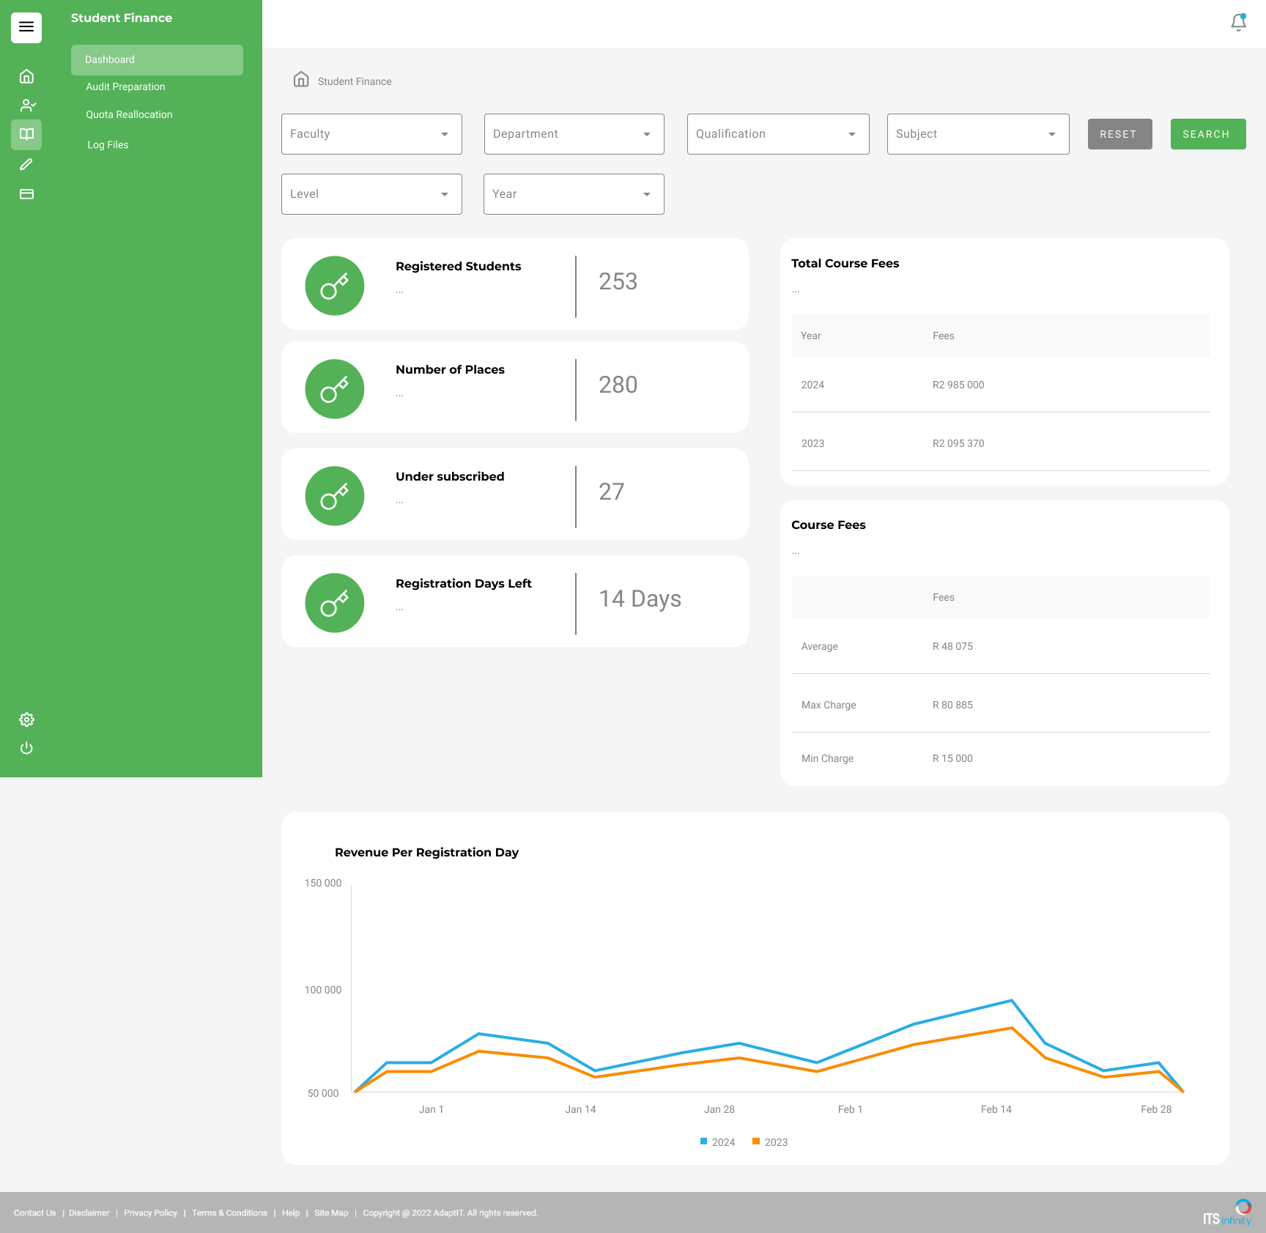

Slide 16
There must be an easier way of doing this?”​

Slide 17
Questions ?

Slide 19
Value Proposition
Save staff hours
Data consistency
Accuracy
Accountability
Communication
Collaboration
Analysis

